Slide 1
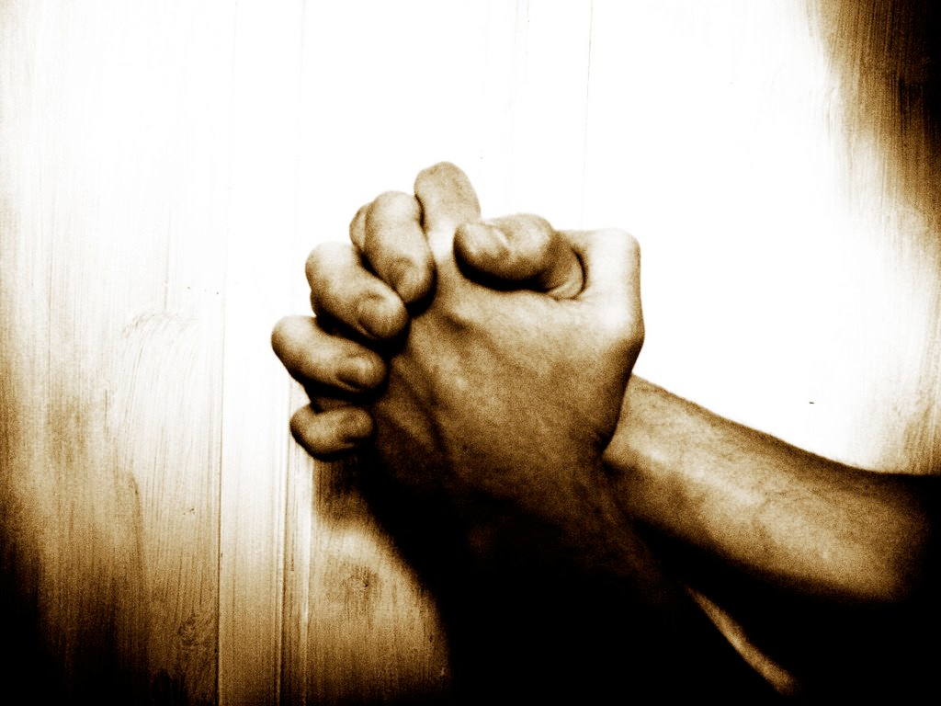
Jesus, One with God in Prayer

Slide 2

The Power of Prayer
What is a prayer?
Prayer is ongoing communication with God.
  We communicate in all sorts of ways with our friends- phone calls, emails, texts, Instagram, Snapchat etc.
Prayers don’t control God or manipulate Him into granting our wishes.
Prayers are answered in different ways:
      https://drive.google.com/file/d/0BzVsPadNVAuMN0ZhRGhXY0lCcm8/view

Slide 3
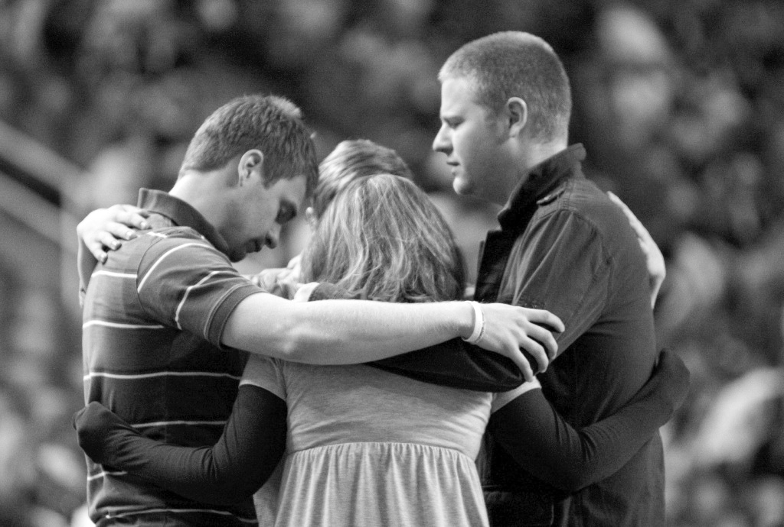
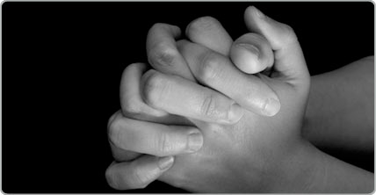
How to pray
As Christians, we are called to pray as Jesus prayed:
    alone
    with others
    with words
    in silence

Slide 4
The Prayer of Jesus
Prayer is so we can connect with God and build a relationship with Him.
God knows what we need without us asking for it.
But God invites us to be close to Him- we can become closer to God through prayer.

Slide 5
EXIT SLIP
I can better my prayer life by....

Slide 6
The Gift of Prayer
Prayer is a gift God gives us- to connect with Him.
We are called to pray as individuals and as a community.
  some examples:
    Liturgy of the Hours
    Mass!

Slide 7
Expressions of Prayer
Vocal Prayer- speaking aloud or silently in our heart.
  Can include traditional prayers:
      Lord’s Prayer, Hail Mary, Act of Contrition etc.
  Or can be personal, spontaneous prayer
      One we make up- we simply speak to God and say what’s on our hearts.

Slide 8
Expressions of Prayer Cont.
Meditation- a prayer in which we are silent and concentrate on listening to God through our feelings, imagination, and thoughts.
  Meditation is thinking about God’s presence in our lives and choosing what He wants us to do.
Contemplation- a form of wordless prayer. It is simply being in God’s presence.

Slide 9
Adoration
Eucharistic Adoration- when the Blessed Sacrament is exposed and adored.
  adoring and honoring the Eucharistic Presence of Christ.
          During Eucharistic Adoration we “watch and wait” we remain “silent” in His Presence and open ourselves to His Graces which flow from the Eucharist.
-Monstrance -a sacred vessel in which the consecrated Host is exposed for the adoration of the faithful

Slide 10
Prayer in Action
Prayer requires commitment and trust:
  It’s a time commitment
  It requires trust in God.
When prayer becomes an integral part of our lives, it becomes all that we say and do.
    our life then becomes a prayer!

Slide 11
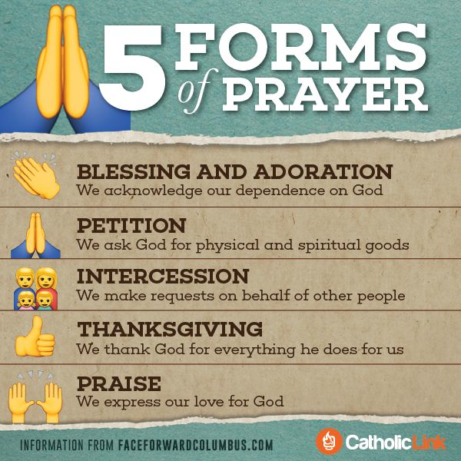

Slide 12
Fun Fact
Ever wonder why we say “God bless you” when someone sneezes?
In the sixth century, when Gregory the Great was Pope, he asked people to pray as a way to combat bubonic plague.
Because a sneeze could signal the start of the disease, the people would say “God bless you,” hoping that the person who sneezed would not get sick.

